Slide 1
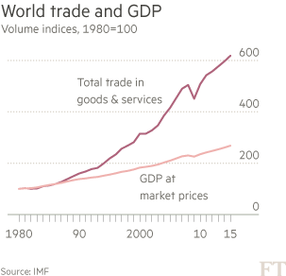
Trends in trade and GDP
Fin Times, “Embattled future of global trade policy”, 13 May 2015, p. 9, by M. Wolf

Slide 2
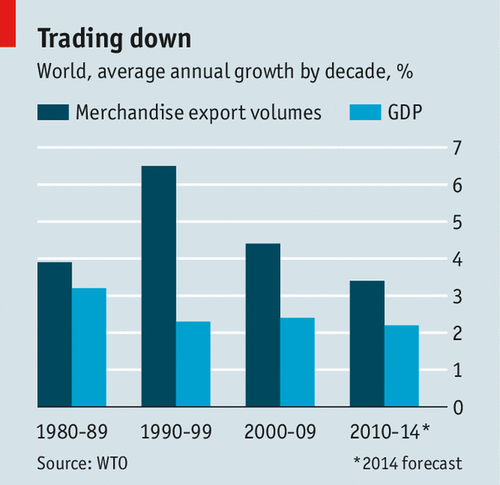
Source: Economist, “International trade: A troubling trajectory”, 13 Dec 2014, p. 65--7

Slide 3
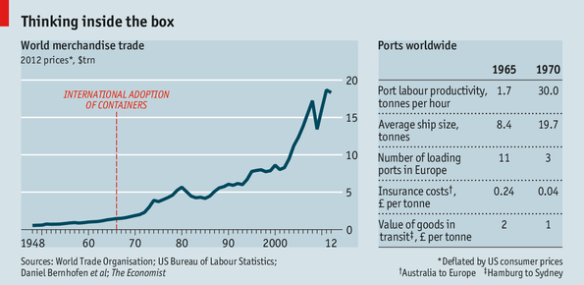
Effect of containerization on trade
Source: Economist, “Free exchange: The humble hero”, 18 May 2013, p. 70

Slide 4
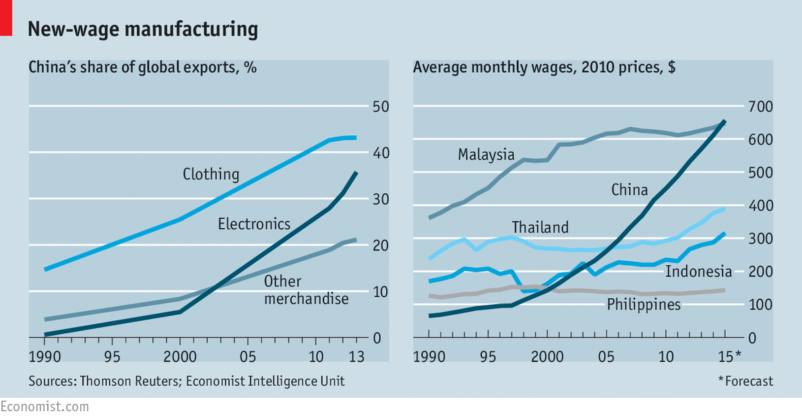
Source: Economist, “Briefing – The future of factory Asia: A tightening grip”, 14 Mar 2015, p. 61-2

Slide 5
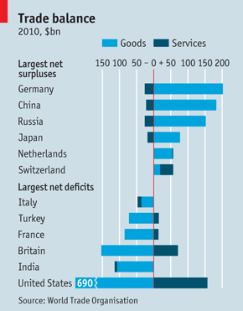
Largest net exporters/importers
Source: Economist, Economic and Financial Indicators, “Trade Balance”, 16 Apr 2011, p. 94

Slide 6
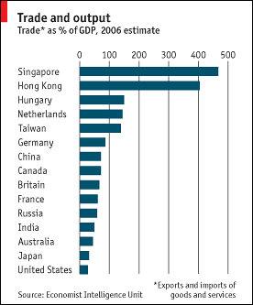
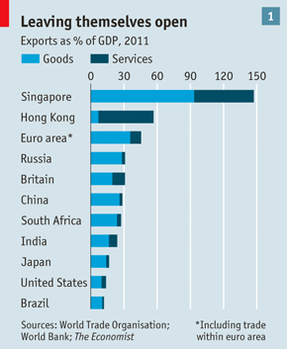
Trade * as % of GDP, 2006 estimate
Exports % of GDP, 2011
Sources: Economist, 8 Feb 2007
Economist, “International Trade: Boxed In”, 8 Sep 2012, p. 59

Slide 7
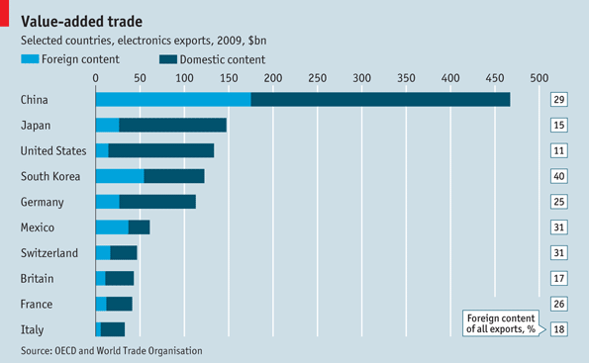
Value-added in electronics and total exports
Economist, “Economic and financial indicators: Value-added trade”, 19 Jan 2013, p. 85

Slide 8
Trade in goods by type, volume (1950=100)
log scale
Manufactures
Mining
Agriculture
100
1950
55
60
65
70
75
80
85
90
95
00
05

Slide 9
Commodity prices by type, (1990=100)
Non-fuel primary
120
Manufacturing
100
80
Petroleum
1990
91
92
93
94
95
96
97
98
99
00
01

Slide 10
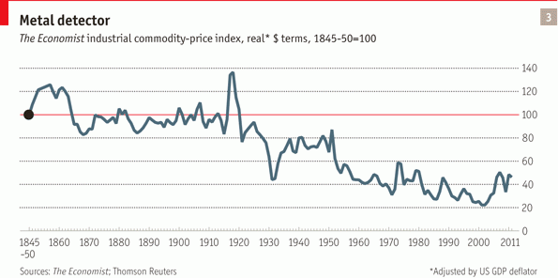
Decline in real industrial commodity prices
Economist, Special Report: The World Economy, “Commodities: Crowded out”, ” 24 Sep 2011

Slide 11
Annual real commodity price indexes
Source: World Bank

Slide 12
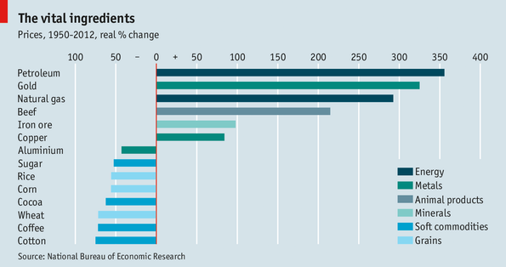
Real commodity price changes, industrial and food
Economist, “Free exchange: Shocks and ores”, 8 Jun 2013

Slide 13
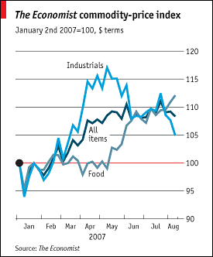
Source: Economist, 18 Aug 2007

Slide 14
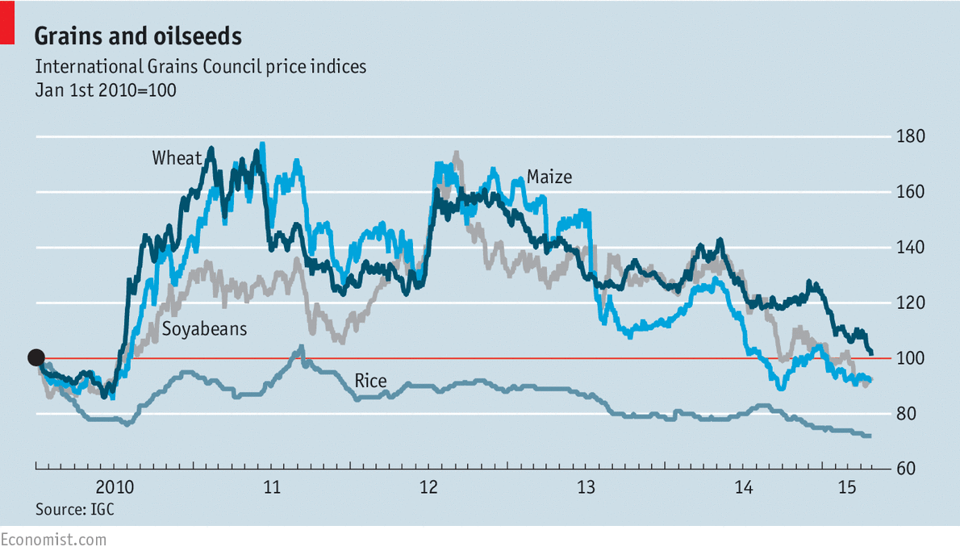
Source: Economist, “Grains and oilseeds”, 2 May 2015, p. 81

Slide 15
Share of primary products of exports of LDCs,
(1970-2001)
%
100
Africa
80
Middle East
60
Latin America
40
Developing economies
20
Developing Asia
1970
1980
1990
2000
2005

Slide 16
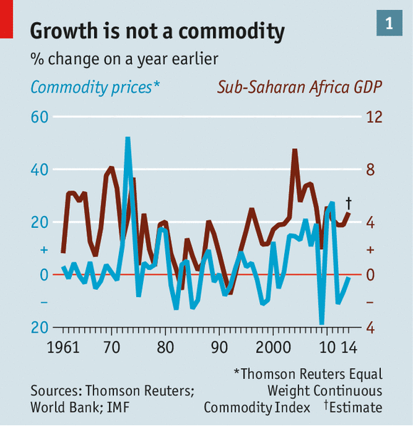
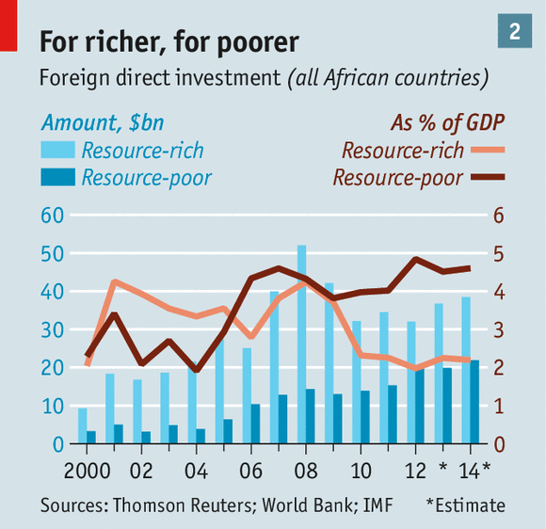
Source: Economist, “African economic growth: The twilight of the resource curse?”, 10 Jan 2015, p. 31-2

Slide 17
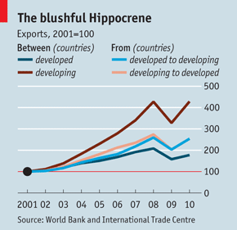
Changing trade patterns
South-South trade
Source: Economist, “Developing-country trade”, 19 Jan 2013, p. 64

Slide 18
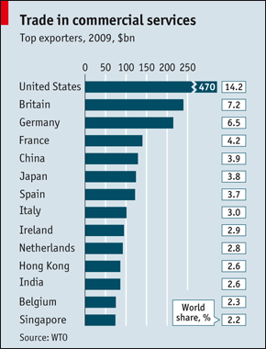
Source: Economist, 18 Apr 2010

