Slide 1
Getting started with Stata
September 2017

Slide 2
Webpage
http://arken.nmbu.no/~kiau/Stata
Here you can find:
Datasets we use today
Exercise Set for today
Dummy do-file
Cheat-sheet with Stata code and useful information
Other useful resources for Stata

Slide 3
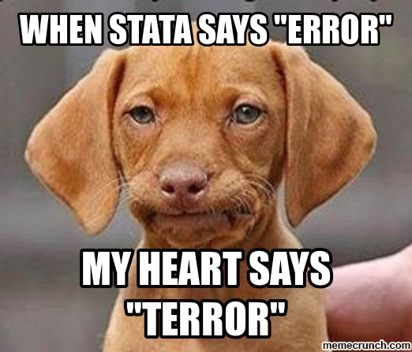
Practice using Stata and avoid..

Slide 4
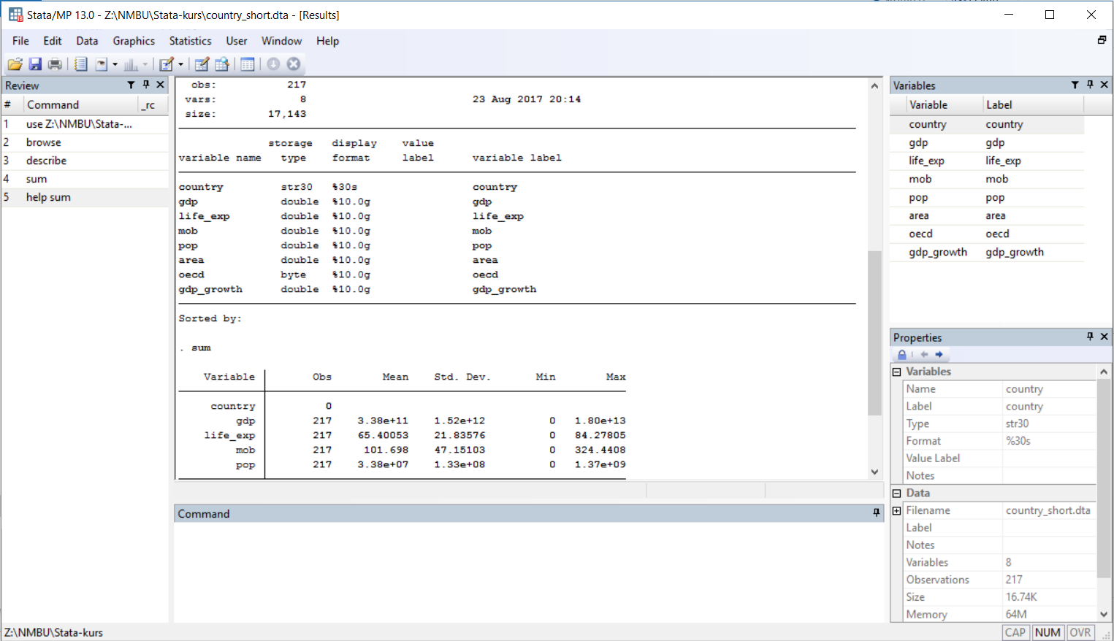
GUI: Graphical User Interface

Slide 5
Interface
Graphical user interface
Result
window
Variable
window
Command
review
window
Command window (write commands here)

Slide 6
Syntax
command varlist, options
Syntax is case sensitive
type
help name_of_command
if you need help

Slide 7
Syntax: Common
Logical
> | Greather than
< | Less than
>= | Greather than or equal
<= | Less than or equal
== | Equal
!= | Not equal
~= | Not equal
Arithmetic
+ | Addition
- | Subtraction
* | Multiplication
/ | Division
^ | Power
( ) | brackets
Numeric and string
& | and
| | or
! | not
~ | not
Mathematical functions
Exp() | Exponential function
Log() | Natural logarithm
Sqrt() | Square root

Slide 8
Do-file
Keep track
Re-run commands
Make modifications
Make comments in do-file
// comment
** comment
/* comment */

Slide 9
Before get to work..
Create a folder for this course on your server
Go to webpage http://arken.nmbu.no/~kiau/Stata and download Excel file country_short and the pdf-file To Do List to the folder.

Slide 10
Launch Stata
Start -> Programs -> Stata

Slide 11
Exercise Set
Go to webpage http://arken.nmbu.no/~kiau/Stata and download Excel file country_long and the pdf-file Exercise Set
… and get cracking!

