Slide 1


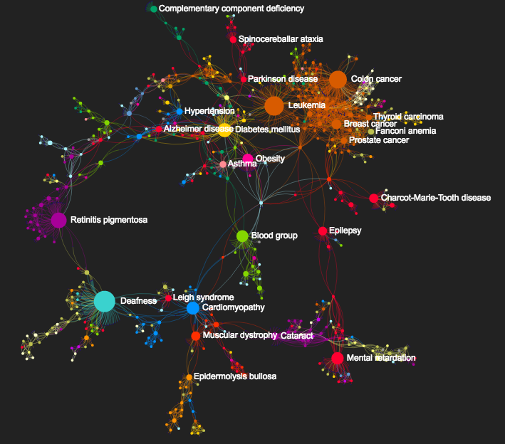
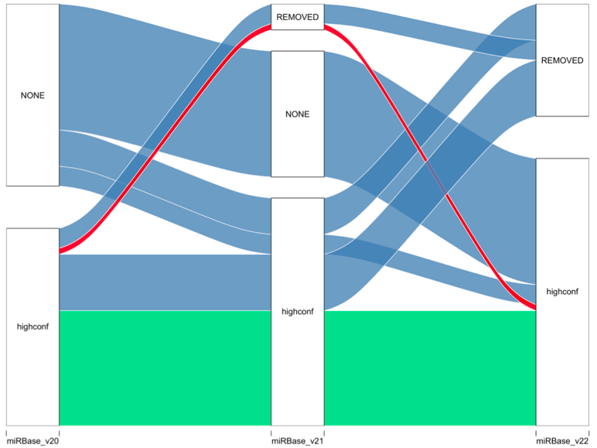
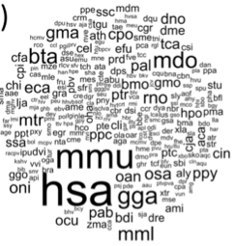
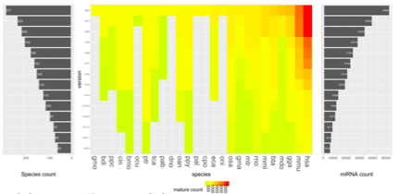
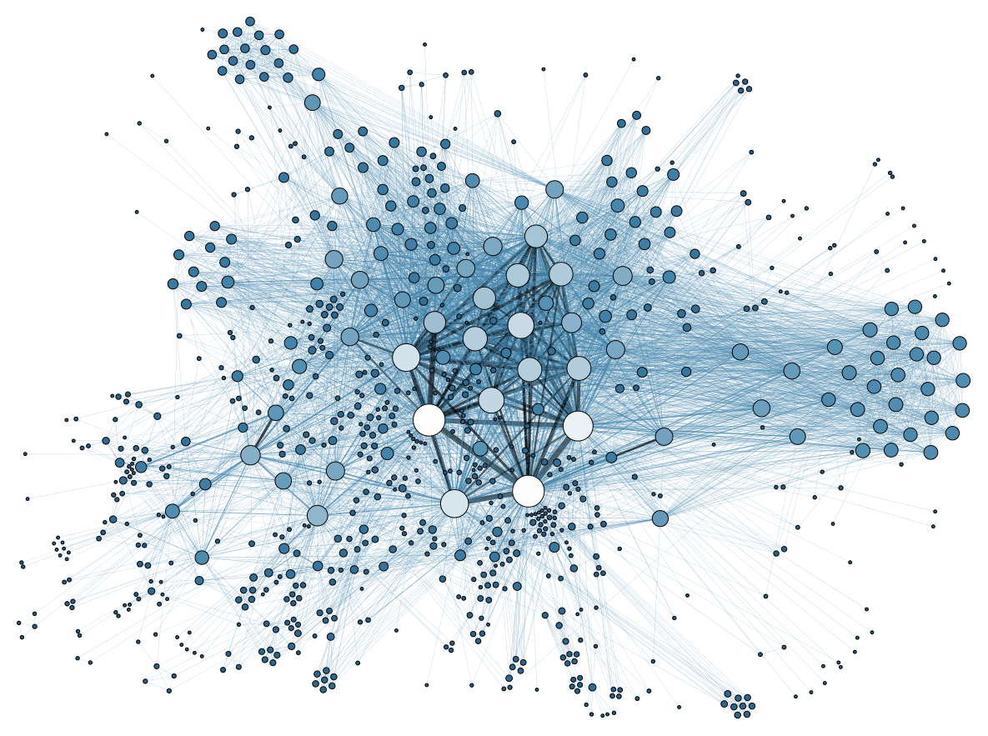
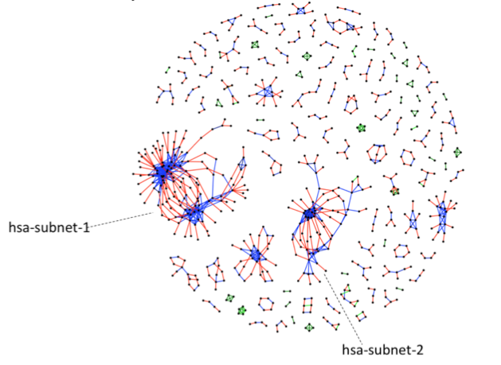

Computational Biology Group
UiO / Oslo Universitetssykehus
Avdeling Medisinsk Genetikk
The computational biology group is focusing on mining the human genome to find genetic associations with disease.
We are interested in the non-coding genome and gene regulation (and miRNAs in particular)
To do this, we develop and use computational, theoretical and experimental methods.
We have a range of masters projects in these areas…
Type 2 Diabetes
Human Cytomegalovirus
Cardiovascular Disease
miRNAs
Java
Python
NGS
Data
Analysis
Deep
Learning
Kontaktinformasjon: simon.rayner@medisin.uio.no

Slide 2





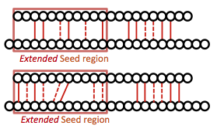
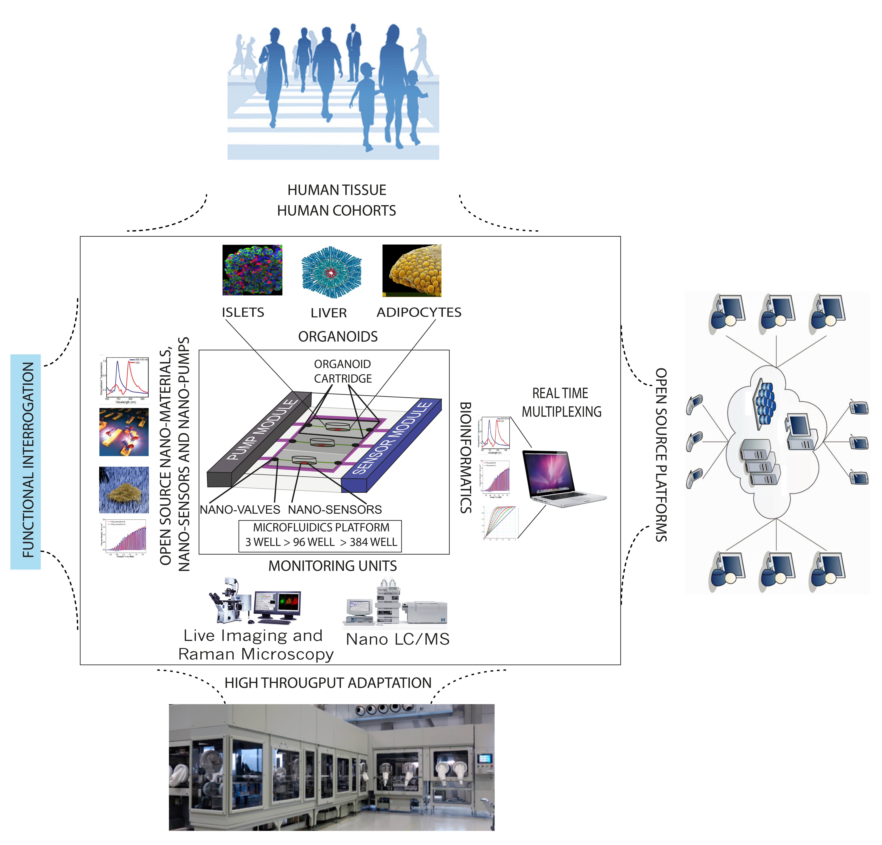

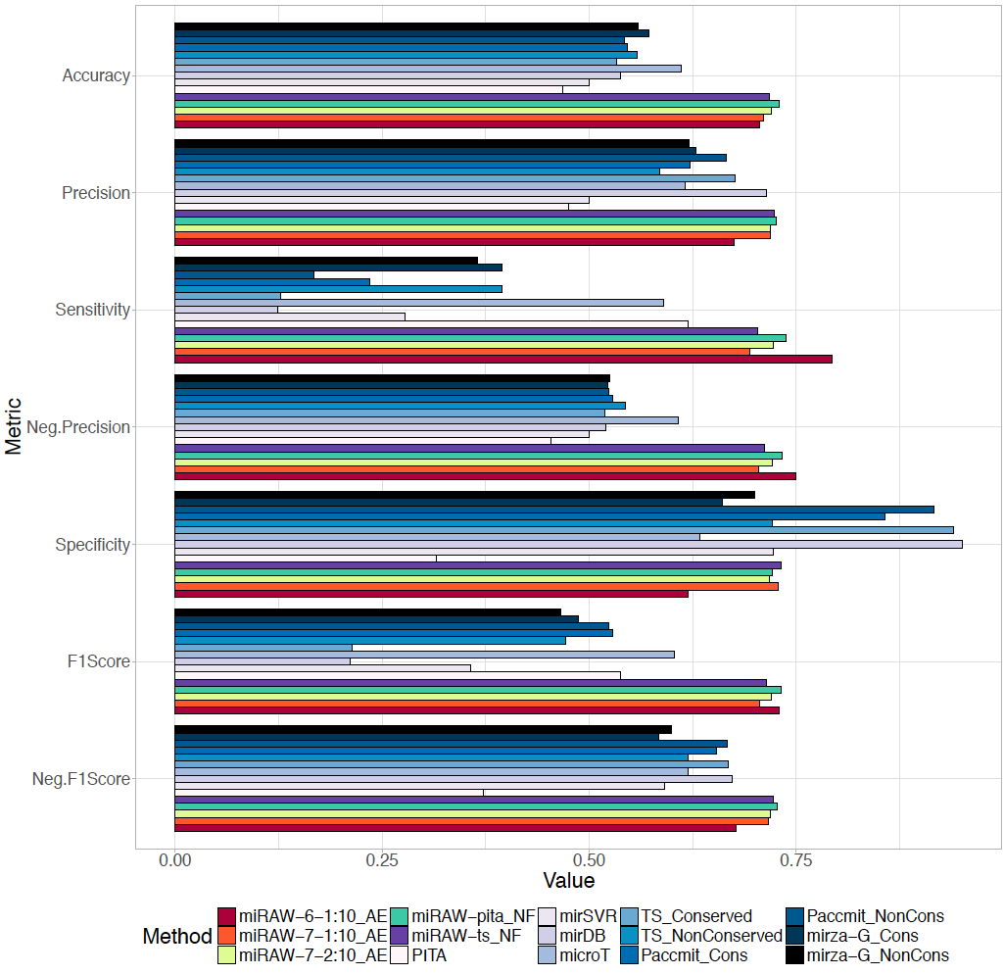
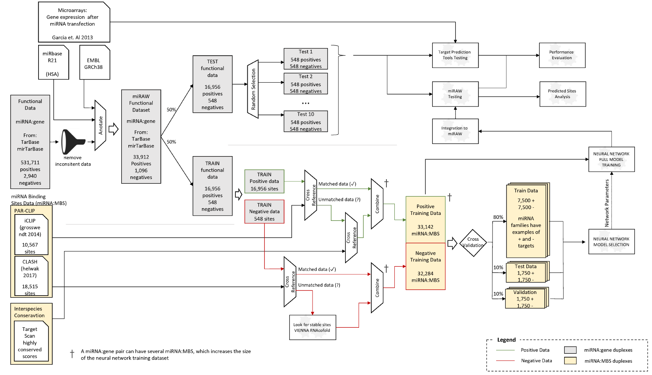
Computational Biology Group
UiO / Oslo Universitetssykehus
Avdeling Medisinsk Genetikk
miRNAs and isomiRs
experimental investigation of miRNA-mRNA targeting
developing an miRNA ontology
deep learning to mine miRNA targeting datasets
SFF ORGANOID ON A CHIP
Other Stuff
Our recent publication in PLoS Comp Bio
NFR funding to study miRNAs and Type2 Diabetes
Collaborators
Chinese Academy of Sciences HCMV
Organoid on a Chip –UiO
University of Cambridge/Wellcome Trust
TEXT MINING
DEEP LEARNING
DATA MINING
Kontaktinformasjon: simon.rayner@medisin.uio.no

